Slide 1

Spark Architecture 2

Slide 2

Components High Level
Master/WorkerAchitecture.
Spark Driver Program
SparkContext
Spark Session
Cluster Manager
Executors
Task
Shuffle and Result
Image source: https://spark.apache.org/docs/latest/cluster-overview.html

Slide 3
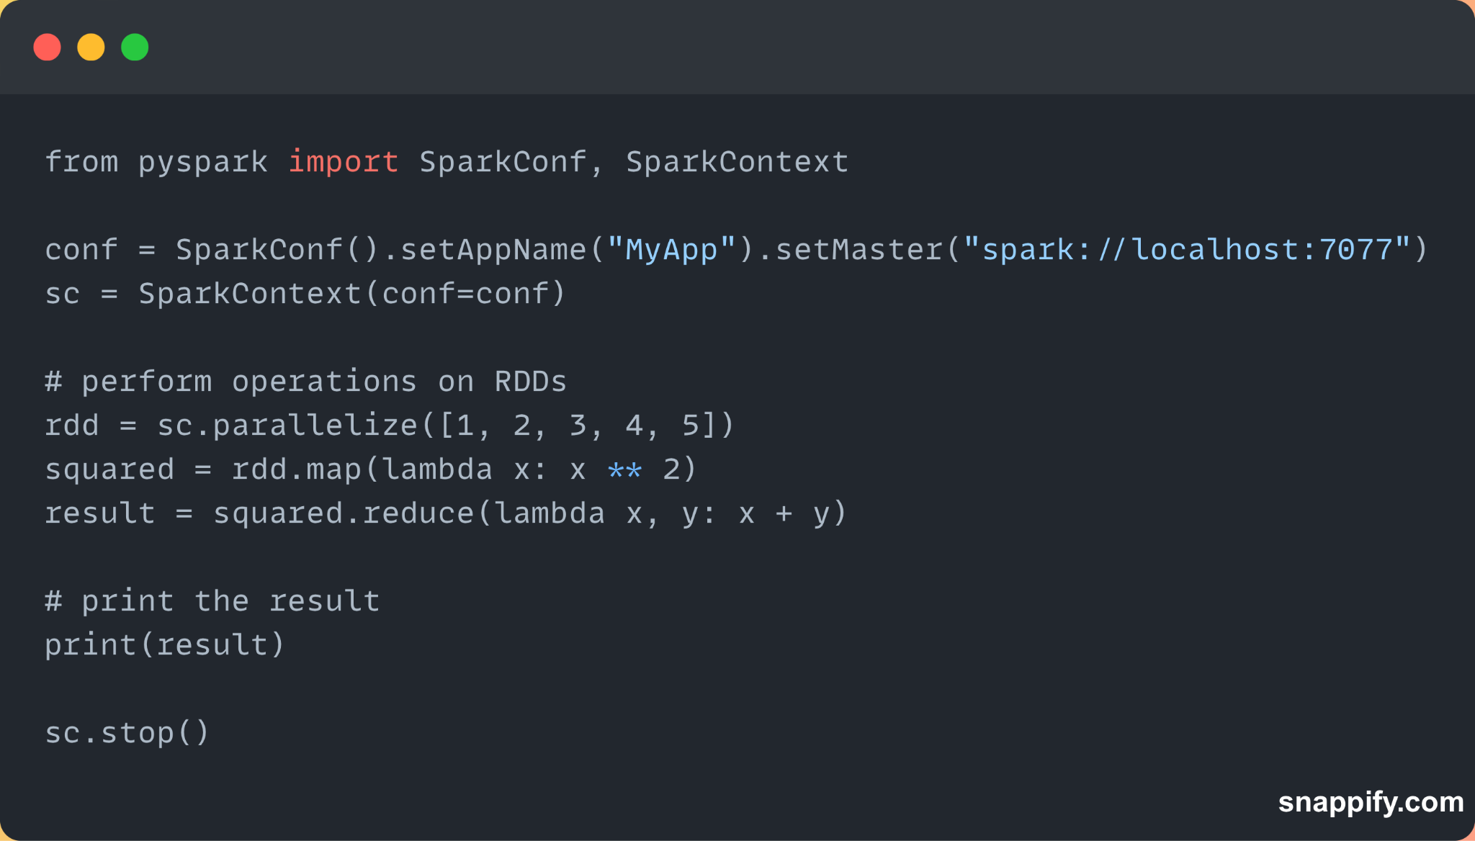
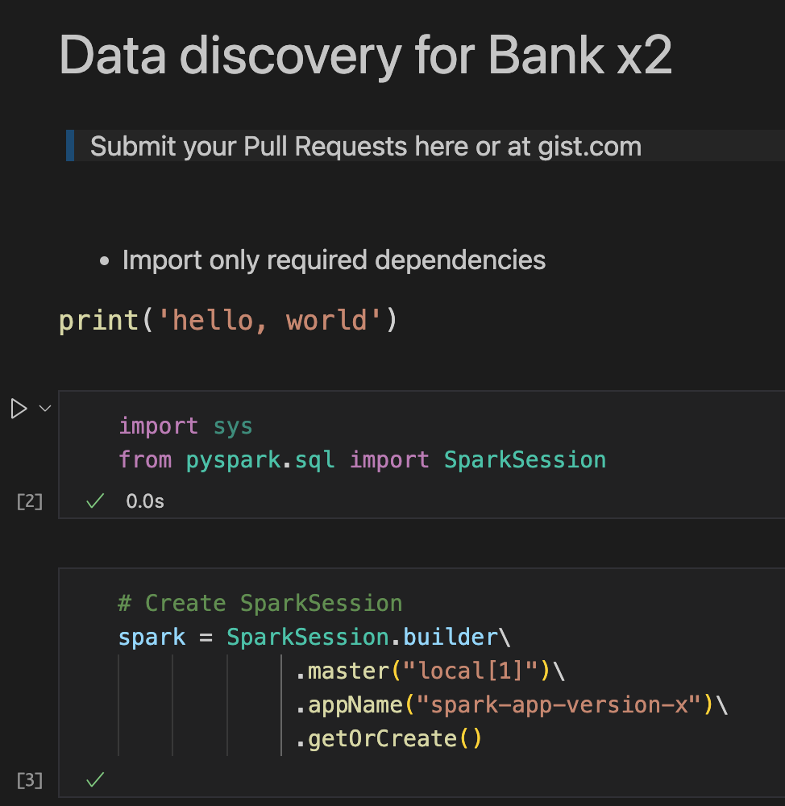
Spark Session vs Spark Context
Spark 2.0 introduces a higher level of abstraction for RDD
In Spark 2.0+ Spark context is no longer the main entry point
Spark Context was the entry point for RDD (lower abstraction levels).
For Dataframes or datasets, use Spark Session (higher level abstraction)
Spark Session is the entry for DF, DS, SQL, Streaming, ML, graph
*RDD (resilient distributed dataset), DF and DS yet to be explained

Slide 4
Cluster Manager
Used for managing Nodes and assigning tasks
Responsible for acquiring resources for application
e.g. CPU cores, memory, etc
Allows for efficient use of resources

Slide 5
Types of Cluster Managers
Standalone :
Built in for testing and development
Apache Mesos :
General Purpose able to run multiple applications frameworks on a shared resource pool
Hadoop YARN:
Part of a Hadoop ecosystem to manage resources
Kubernetes :
Container Orchestration used for managing Clusters

Slide 6
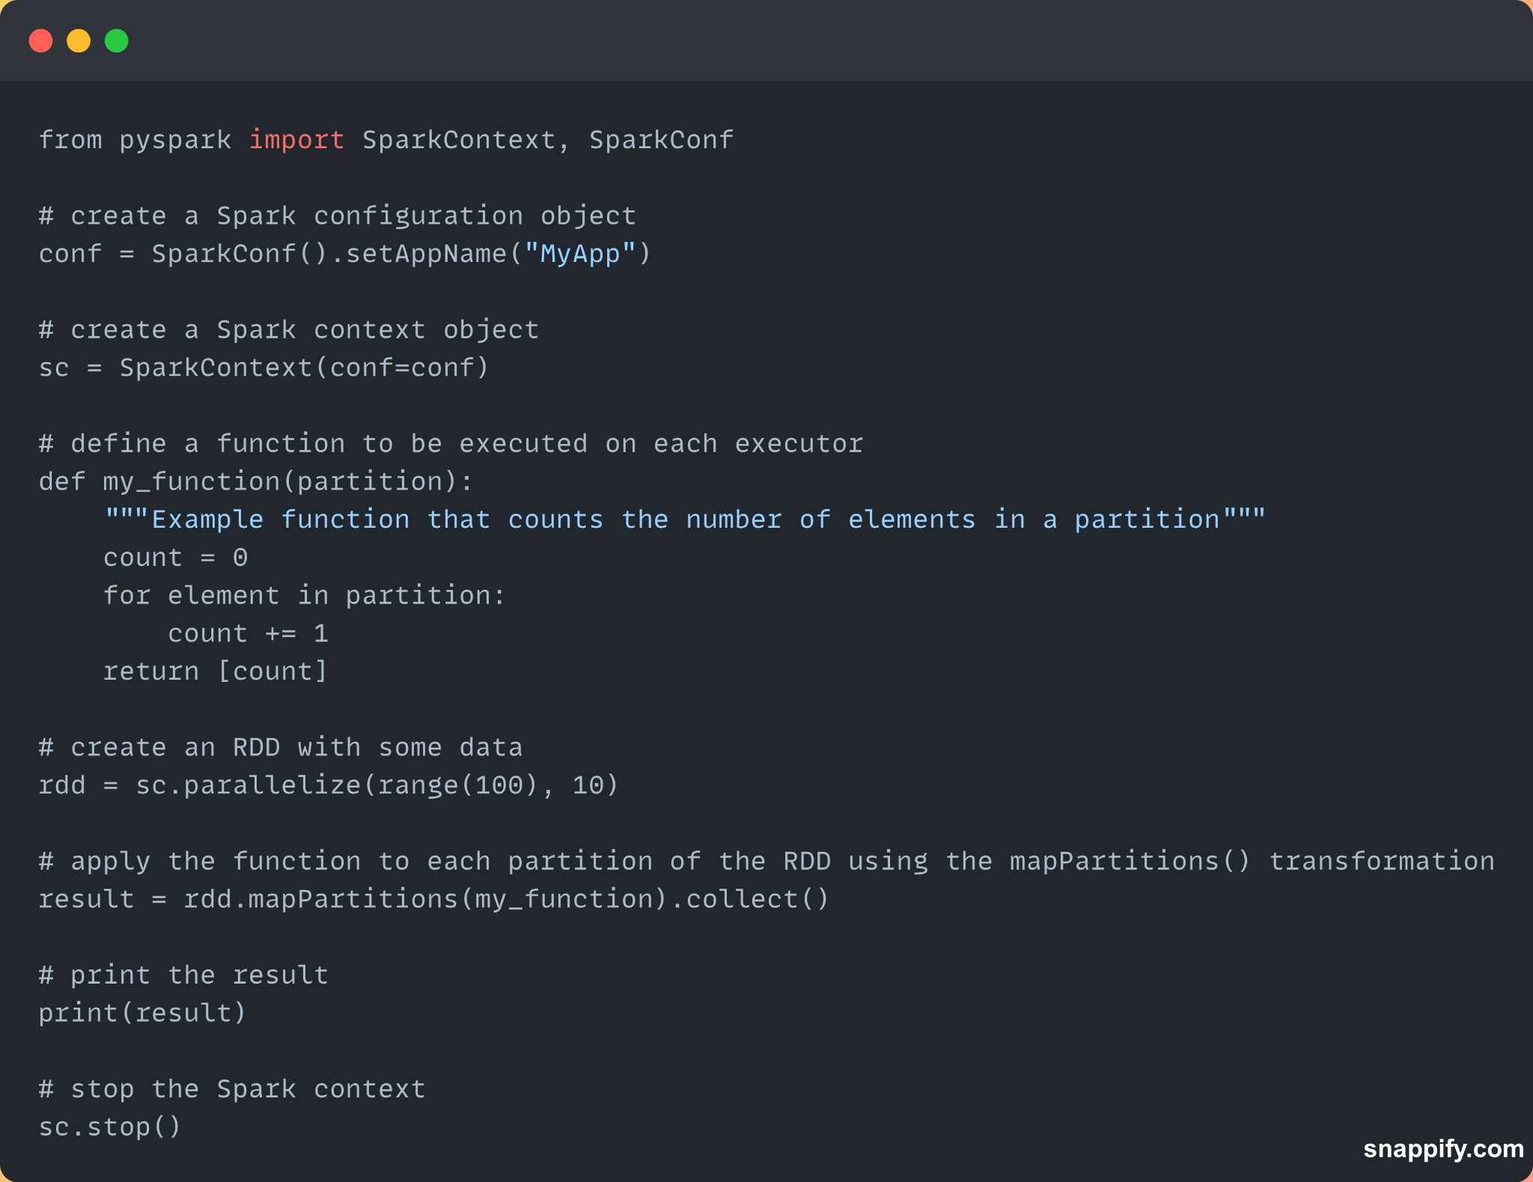
Executors
Responsible for executing tasks
Through life time of the application
Own JVM process
Executing subset of tasks
More executors -> parallelism -> better performance
(in most cases!)

Slide 7
Task
Smallest unit of work that can be executed
Spawned by Executors as part of Spark Job
Responsible for processing a subset of the RDD
Tasks are executed independently / parallel
Finished result is then sent to a task or driver program

Slide 8
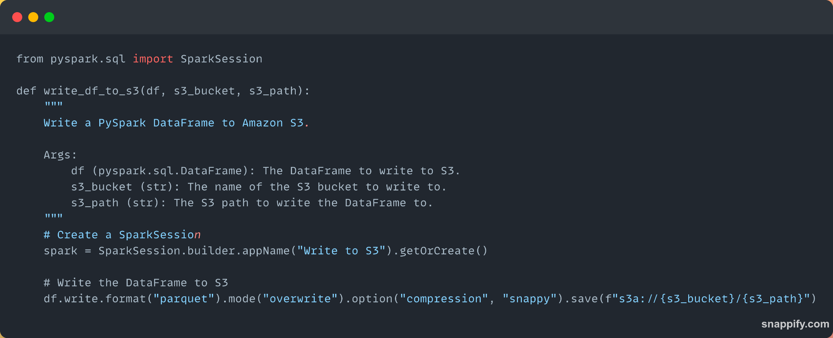
Result
Output / final outcome of a computation / transformation performed on a distributed data set (RDD or DataFrame)

Slide 9
Next…

